Slide 1
R
Apply

Slide 2
Apply(),
lapply()
Sapply
Mapply
Rep
Sweep
Aggregate

Slide 3
The apply() family pertains to the R base package and is populated with functions to manipulate slices of data from matrices, arrays, lists and dataframes in a repetitive way.
avoid explicit use of loop constructs
the family is made up of the apply(), lapply() , sapply(), vapply(), mapply(), rapply(), and tapply() functions.

Slide 4
apply(X, MARGIN, FUN, ...)
On Arrays
X <- matrix(rnorm(30), nrow=5, ncol=6)
apply(X, 2, sum) # On column
apply(X, 1, sum) # On Row
Rnorm – Random
X generates multivariate normal random variates in the space X.

Slide 5
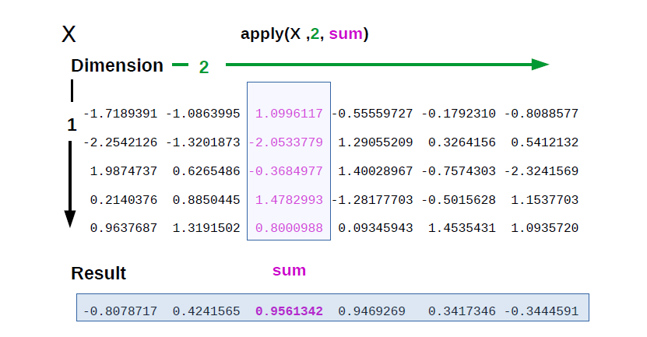

Slide 6
lapply()
objects like dataframes, lists or vectors
You want to apply a given function to every element of a list and obtain a list as result.
L = List?

Slide 7
attach(mtcars)
# Create a list of matrices
MyList <- list(A,B,C)
# Extract the 2nd column from `MyList` with the selection operator `[` with `lapply()`
lapply(MyList,"[", , 2)
# Extract the 1st row from `MyList`
lapply(MyList,"[", 1, )

Slide 8
You use the standard R selection operator [ and then omit the first parameter (which therefore translates into “any”, that’s why you see the two commas).

Slide 9
sapply()
sapply() is a ‘wrapper’ function for lapply().
S- simple
# Return a list with `lapply()`
lapply(MyList,"[", 2, 1 )
# Return a vector with `sapply()`
sapply(MyList,"[", 2, 1 )

Slide 10
# Replicate the values of `Z`
Z <- rep(Z,c(3,1,2))

Slide 11
mapply()
‘multivariate’ apply
Its purpose is to be able to vectorize arguments to a function that is not usually accepting vectors as arguments.
applies a Function to Multiple List or multiple Vector Arguments

Slide 12
# Create a 4x4 matrix
Q1 <- matrix(c(rep(1, 4), rep(2, 4), rep(3, 4), rep(4, 4)),4,4)
# Print `Q1`
print(Q1)
# Or use `mapply()`
Q2 <- mapply(rep,1:4,4)
# Print `Q2`
print(Q2)

Slide 13
attach(iris)
# get the mean of the first 4 variables, by species
by(iris[, 1:4], Species, colMeans)
Essentially, by provides a way to split your data by factors and do calculations on each subset. It returns an object of class “by” and there are many, more complex ways to use it.

Slide 14
# create a list with 2 elements
l <- list(a = 1:10, b = 11:20)
# the mean of the values in each element
lapply(l, mean)

Slide 15
> l <- list(a = 1:10, b = 11:20)
> lapply(l, mean)
$`a`
[1] 5.5
$b
[1] 15.5
> l.mean <- sapply(l, mean)
> l.mean
a b
5.5 15.5
>

Slide 16
tapply(iris$Petal.Length, Species, mean)
lapply(BOD,sum)
apply(BOD,2,sum)
movies <- c("SPYDERMAN","BATMAN","VERTIGO","CHINATOWN")
movies_lower <-lapply(movies, tolower)
str(movies_lower)

